Slide 1
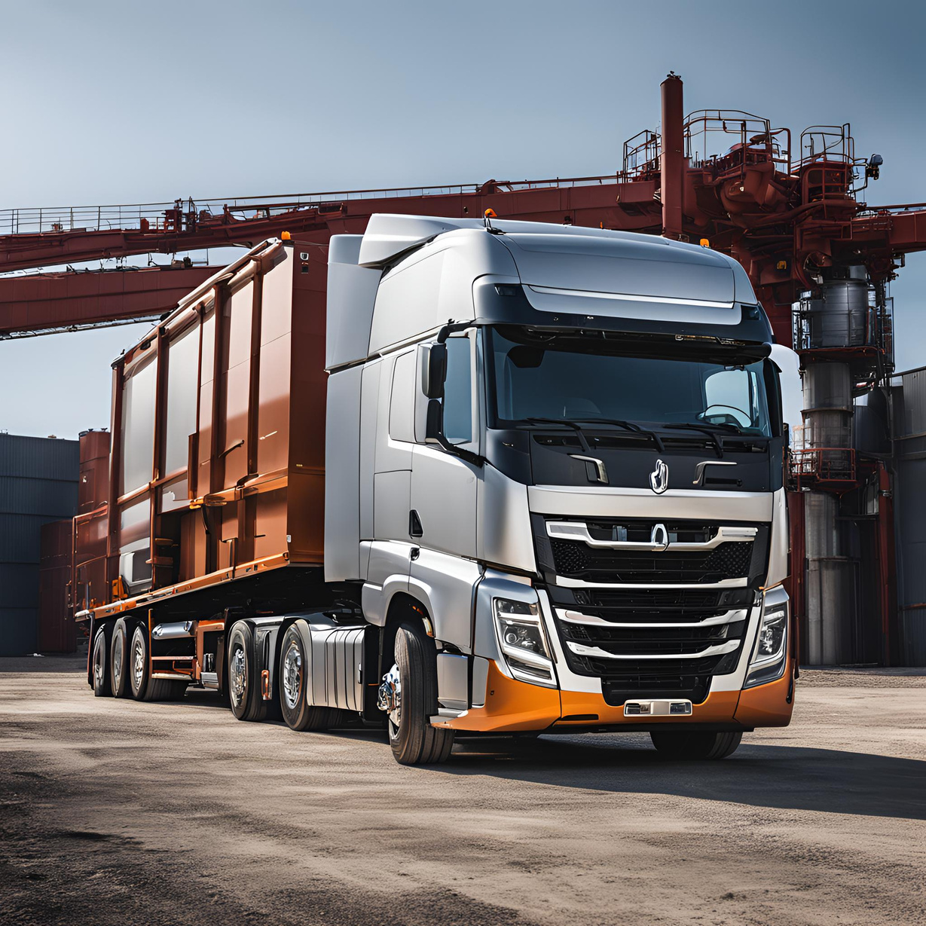
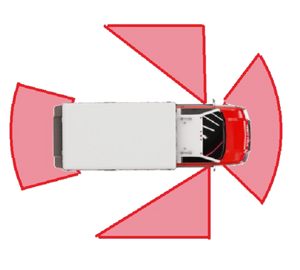
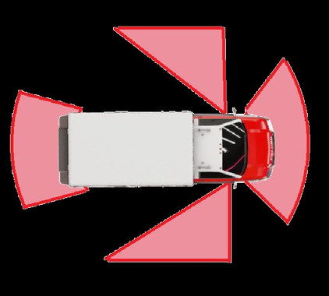
TRUCKER MINDS
ENSURING SAFETY
-THE LAST MINUTE ENGINEERS

Slide 2

PROBLEM STATEMENT

Slide 3
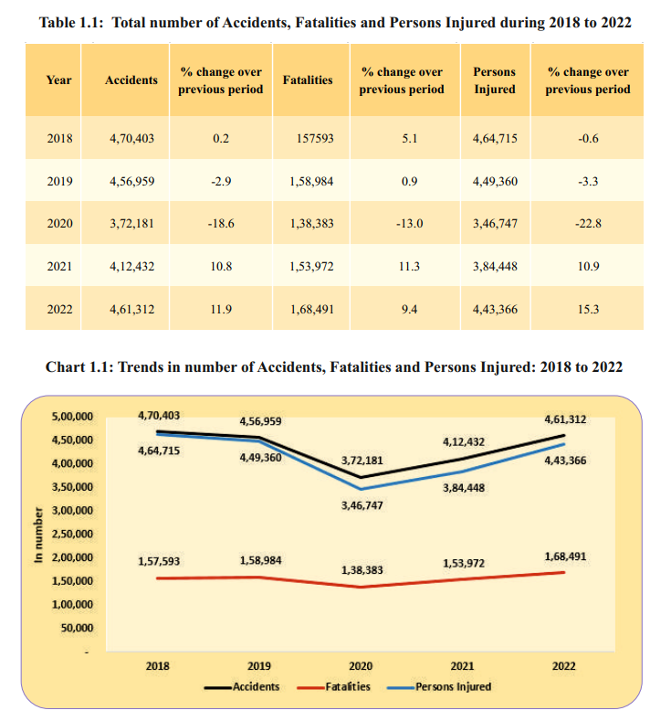
Truck accidents in India are a significant concern, with thousands of fatalities and injuries reported annually.
These accidents not only cause loss of life and injuries but also have a substantial economic impact due to the loss of potential income and increased healthcare costs
~According to Road accidents of India Report 2022

Slide 4
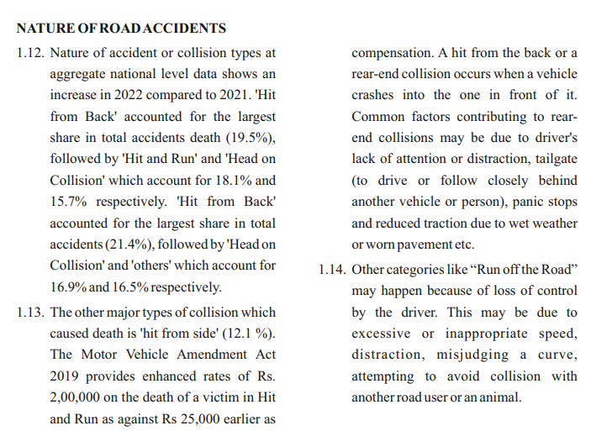
ROAD ACCIDENTS OF INDIA 2022 REPORT ANALYSIS

Slide 5
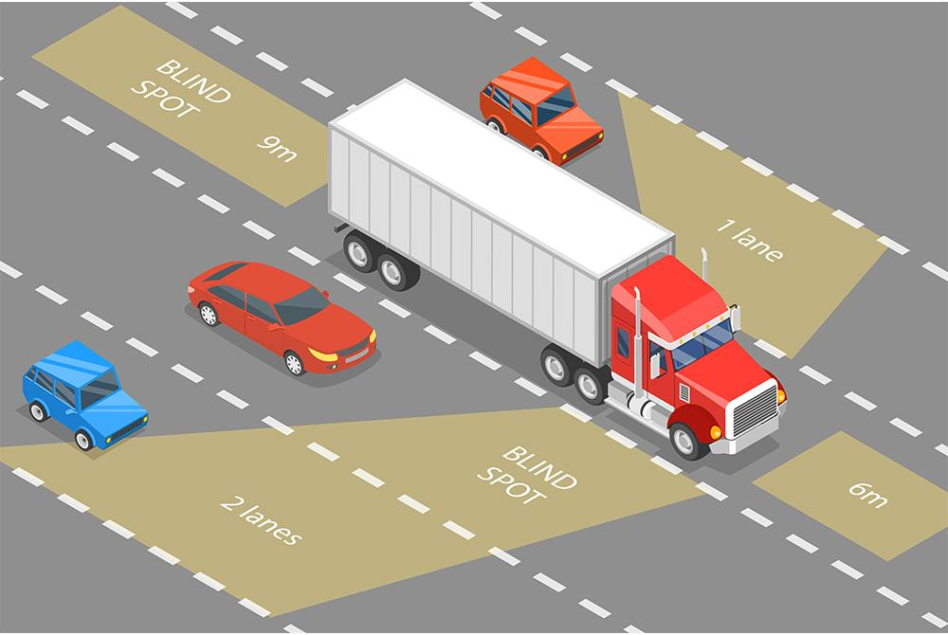
WHAT WE ARE BUILDING...
AN INNOVATIVE PRODUCT THAT CAN ADD EXTRA EYES TO THE DRIVER IN DETECTING VEHICLES AT BLIND SPOTS.

Slide 6

TECHNICAL OVERVIEW

Slide 7


TECH WE USED
OpenCV
Arduino
Python library that helps in detecting the vehicles
The single board micro controller that powers our prototype.

Slide 8
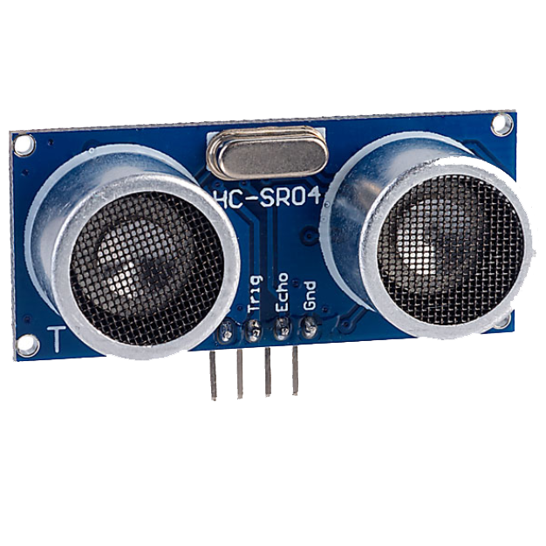
SENSOR AT PLAY
Ultrasonic sensor
This sensor detects the vehicles at close proximity.

Slide 9
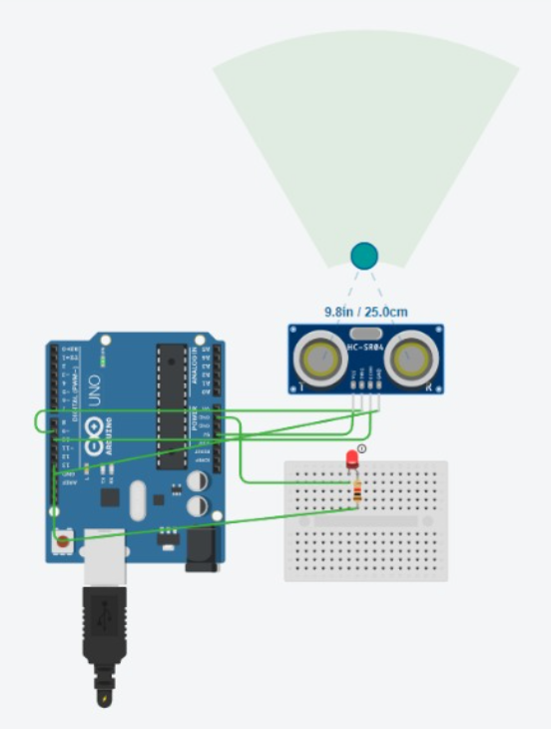
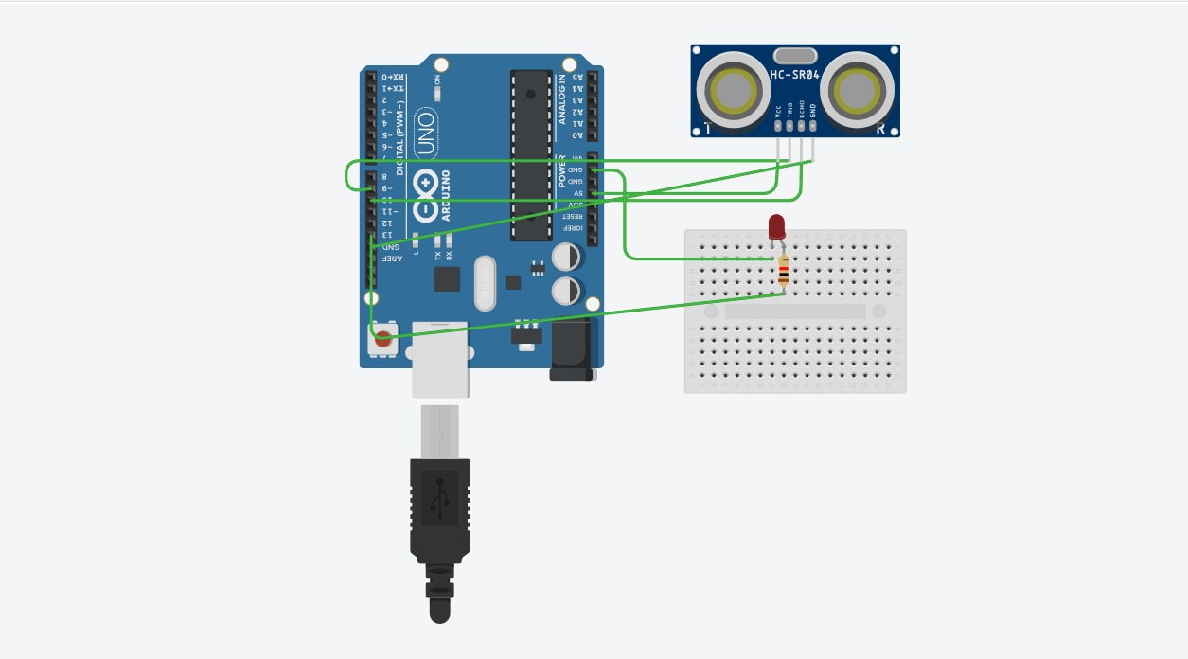
PROTOTYPE SCHEMATIC

Slide 10
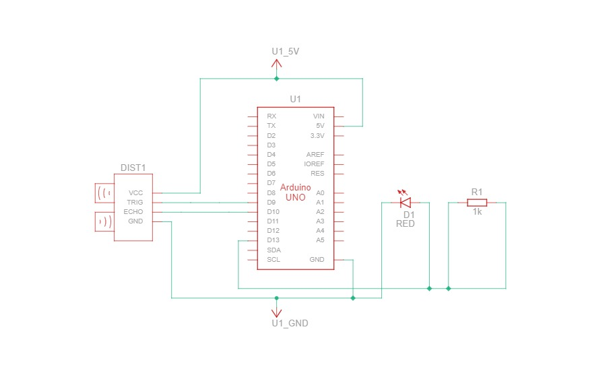

Slide 11



Effective Radar System
FEATURES OF
OUR PRODUCT
The radar sensors ensures that the driver never misses any vehicles and objects in the blind spot forward.
Cost Effective Implementation
The most simple, yet effective solution taht works with minimal resources.
Highly Reliable Camera System
Efficient implementation of frames ensure highly

Slide 12

Inexpensive manufacturing and assembly
BUSINESS ASPECT
Safety enhancement becomes an important selling point to heavy vehicle manufacturers.
Highly customisable sensors to cater various purposes

Slide 13
THANK YOU !
By
THE LAST MINUTE ENGINEERS

